Slide 1
Big Mountain Ticket Price Analysis & Findings
By Matthew Coulombe

Slide 2
Problem Identification
Current Situation: Big Mountain’s current ticket price is $81.
Goal: Identify potential opportunities to increase revenue through ticket prices and facility operations.
Possible Scenarios:
Permanently closing down up to 10 of the least used runs. (Does not impact any other resort statistics)
Increase the vertical drop by adding a run to a point 150 feet lower down but requiring the installation of an additional chair lift to bring skiers back up, without additional snow making coverage.
Same as number 2, but adding 2 acres of snow making cover.
Increase the longest run by 0.2 mile to boast 3.5 miles length, requiring an additional snow making coverage of 4 acres.

Slide 3
Recommendation & Key Findings
Recommendation
New Ticket Price = $86.99
Close and repurpose a run by increasing the vertical drop by 150 feet to be able to add an additional $1.99 to the ticket price. (Scenarios 1 and 2 combined)
Generate over $10 million in additional revenue.
Key Findings
With the resort as is, the minimum ticket price Big Mountain can support is $85 a ticket.
For Scenario 1, closing only 1 run results in no decrease in ticket price, then if any more need to be closed, closing 5 runs would be recommended.
Scenario 2 supported a $1.99 price increase.
Scenarios 3 and 4 produce no change to the ticket price, so they are not recommended.

Slide 4
Modeling Results & Analysis
Dataset:
Data from 330 different resorts across the United States.
No correlation between states
Machine Learning Models:
Linear Regression
Random Forest

Slide 5
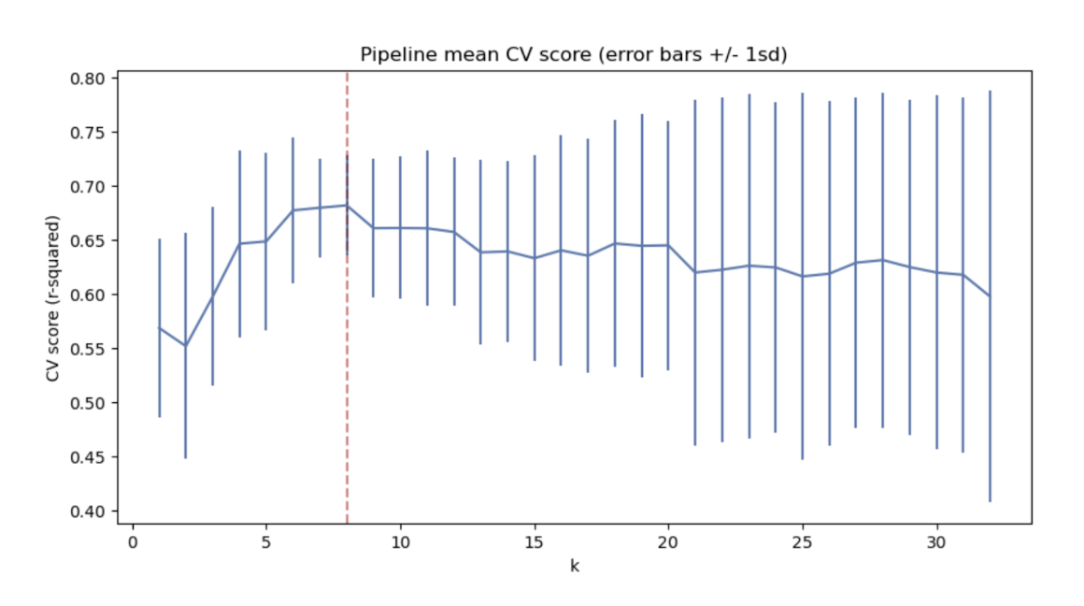
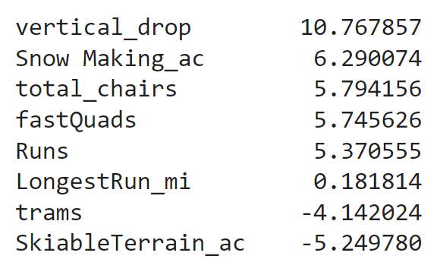
Modeling Results & Analysis (Linear Regression)
8 features performed the best with the least amount of variance and Mean Absolute Error (MAE = 11.79)
The following are the 8 features used (Higher the number, the greater the impact positively or negatively):

Slide 6
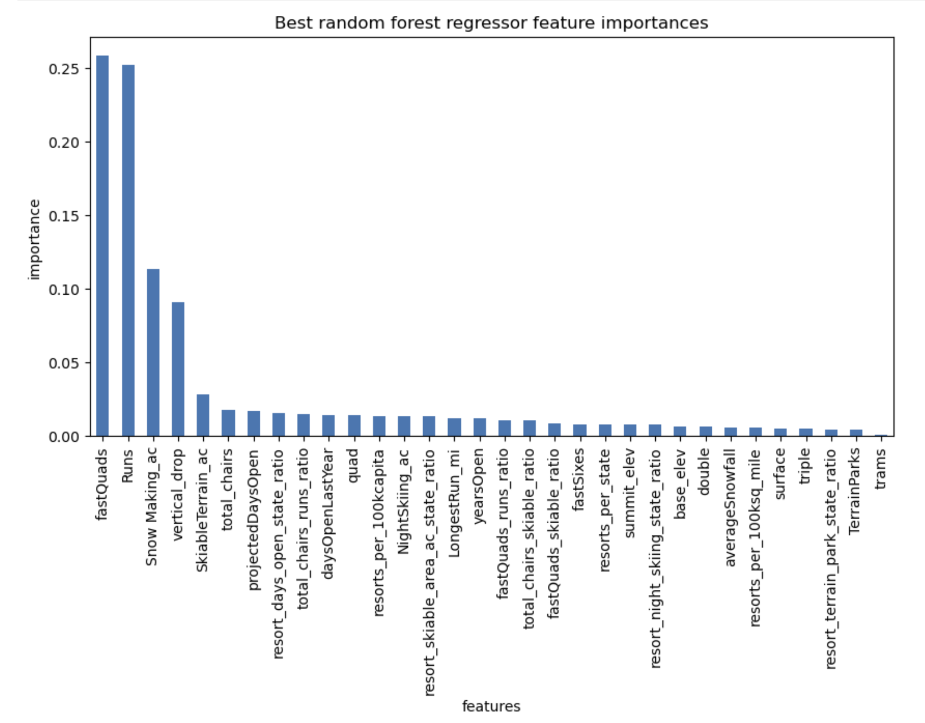
Modeling Results & Analysis (Random Forest)
4 dominant features
fastQuads
Runs
Snow Making_ac
Vertical_drop
Mean Absolute Error (MAE = 9.54)
Since this is the lower MAE between the Linear Model and Random Forest, chose the Random Forest for the main model
With the model in place, we can run Big Mountain through as well as the proposed scenarios to see how ticket price would change.

Slide 7
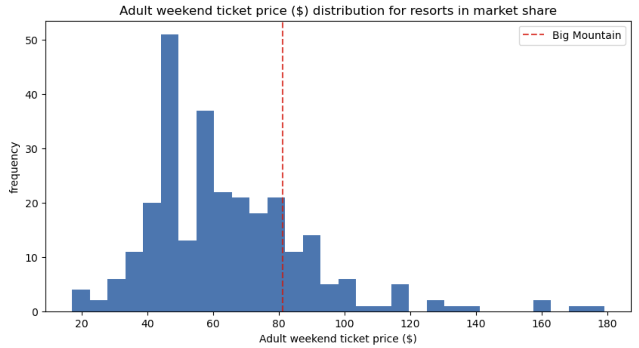
Modeling Results & Analysis (Big Mountain)
Running Big Mountain through the model expects a ticket price of $95.87.
With a mean absolute error of $10.39, a conservative ticket price would be $85 with current facilities.
Big Mountain was high in the ranks for the following features:
vertical_drop
Snow Making_ac
total_chairs
fastQuads
Runs
LongestRun_mi
trams
SkiableTerrain_ac

Slide 8
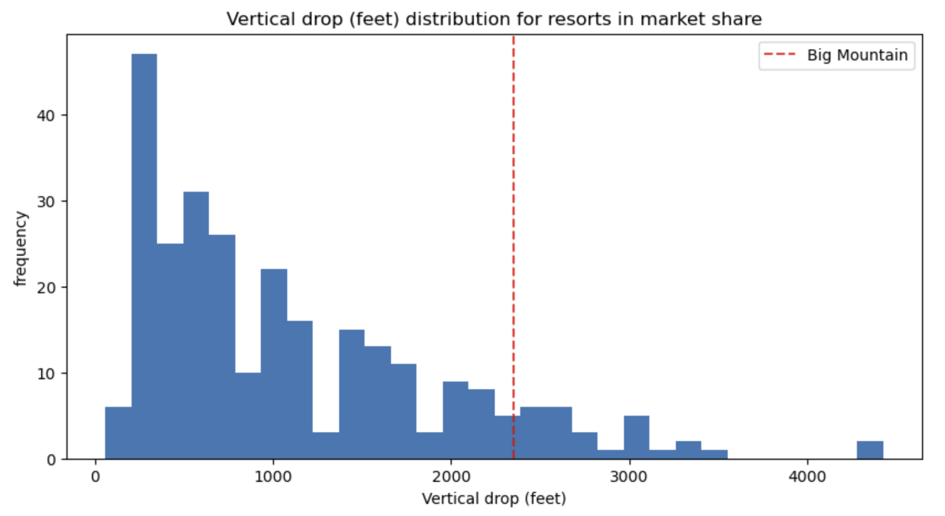
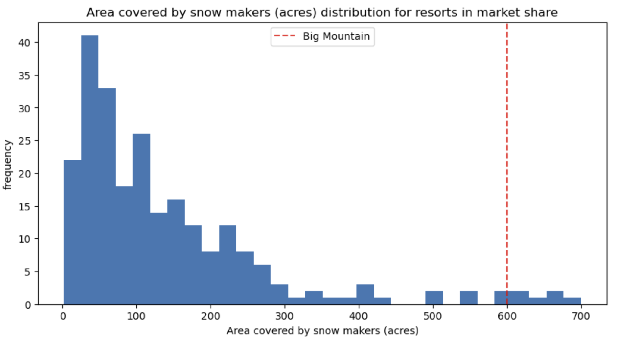
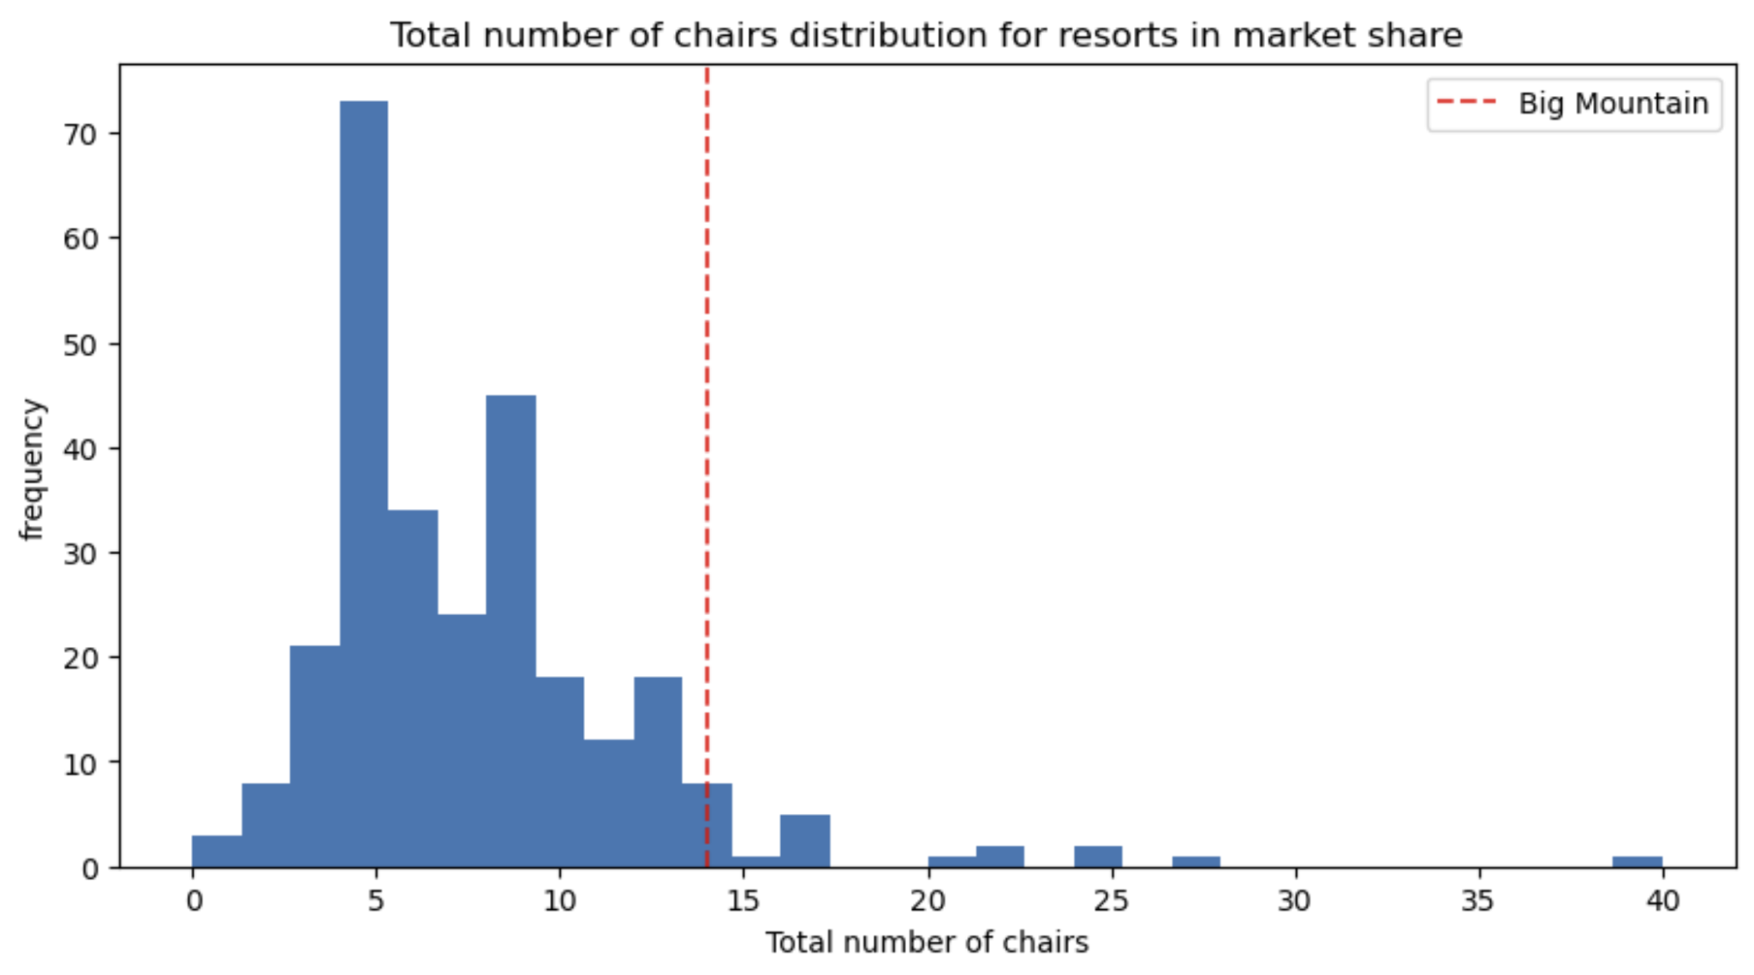
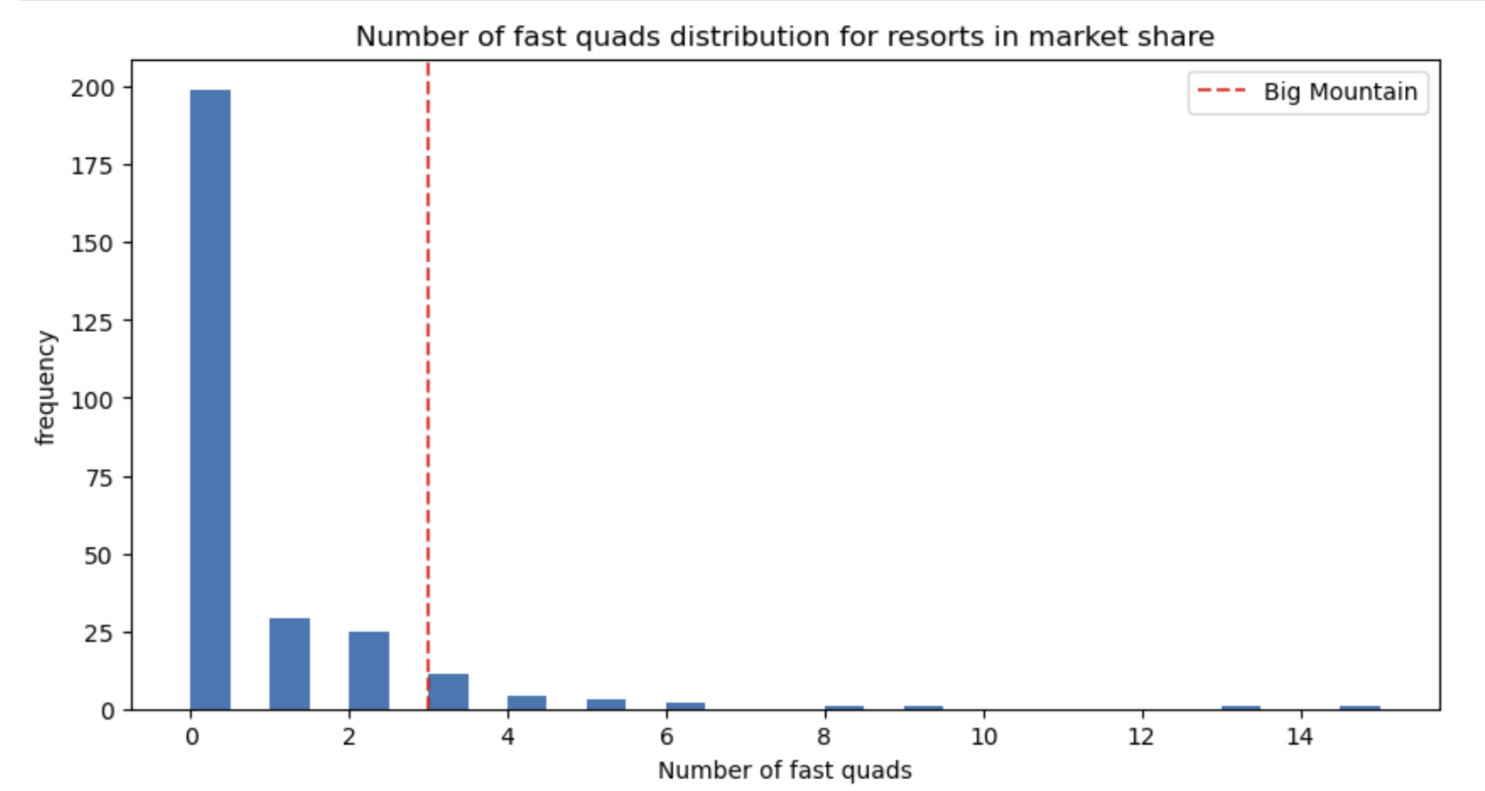
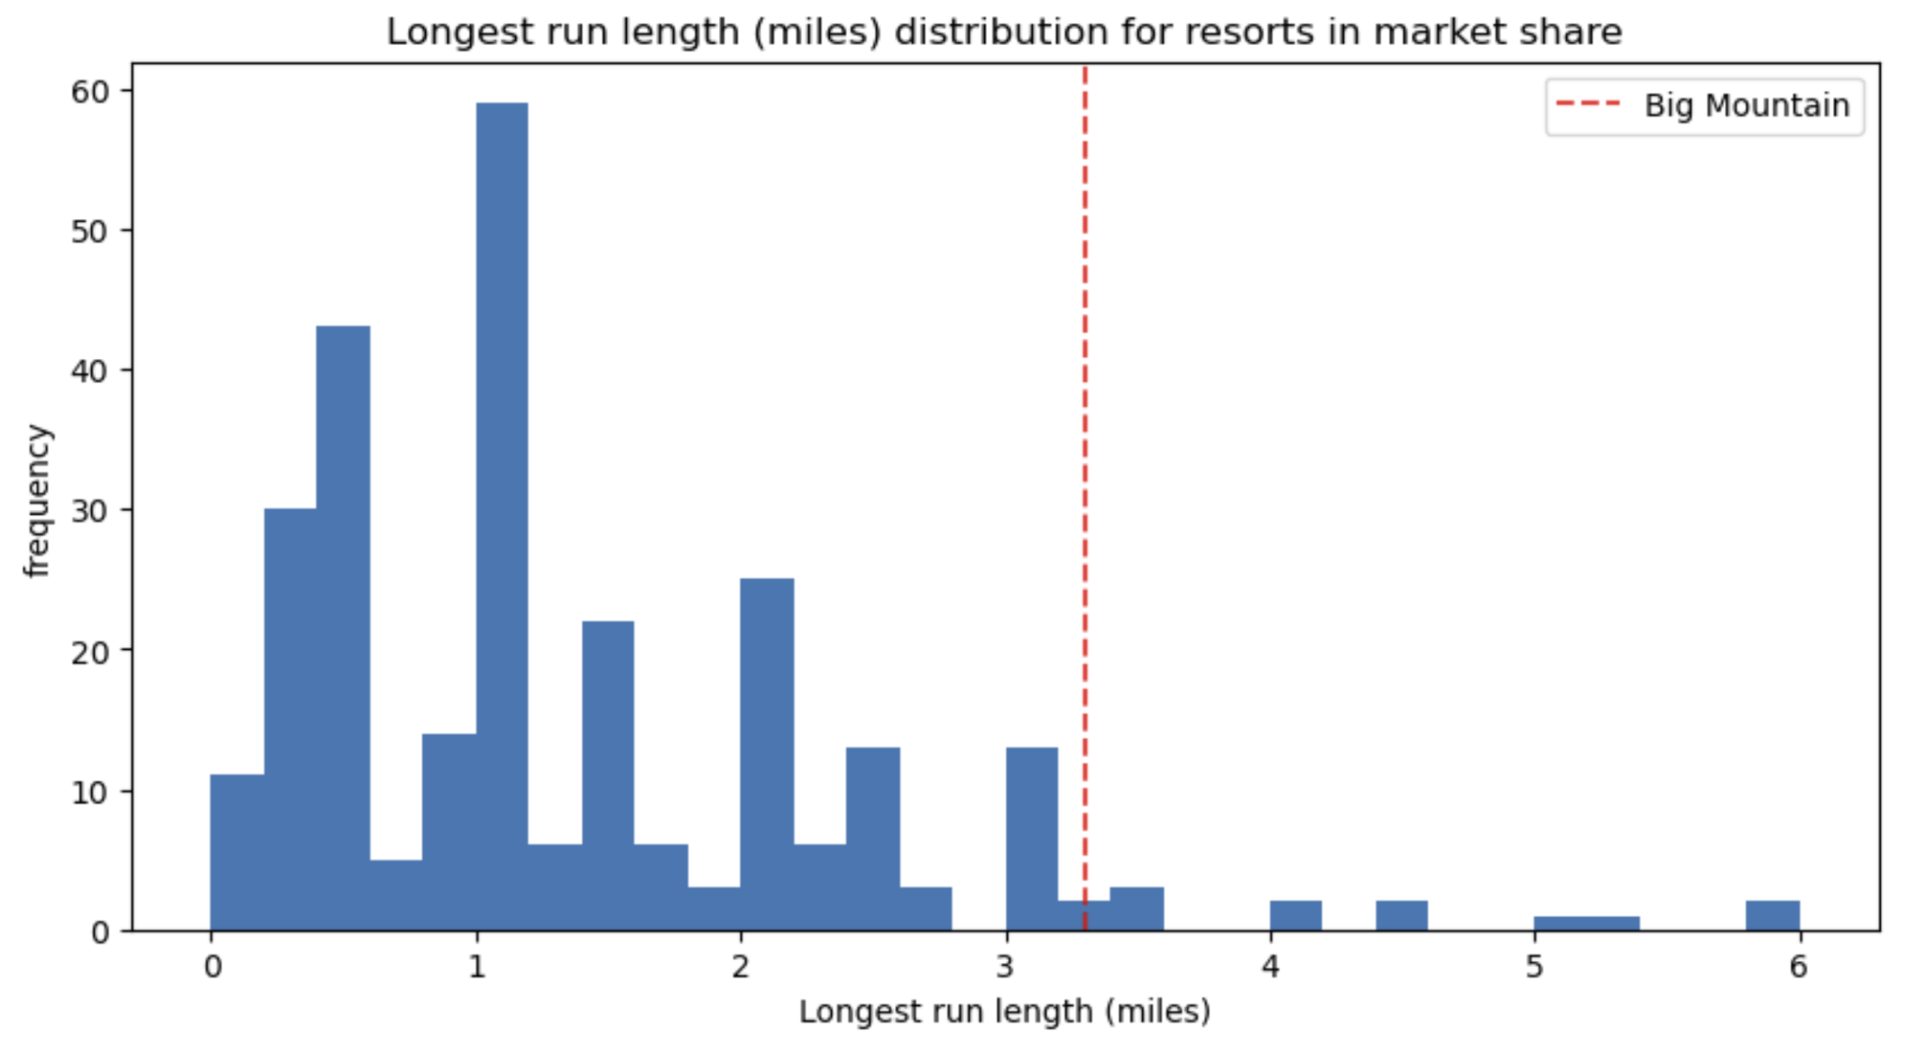
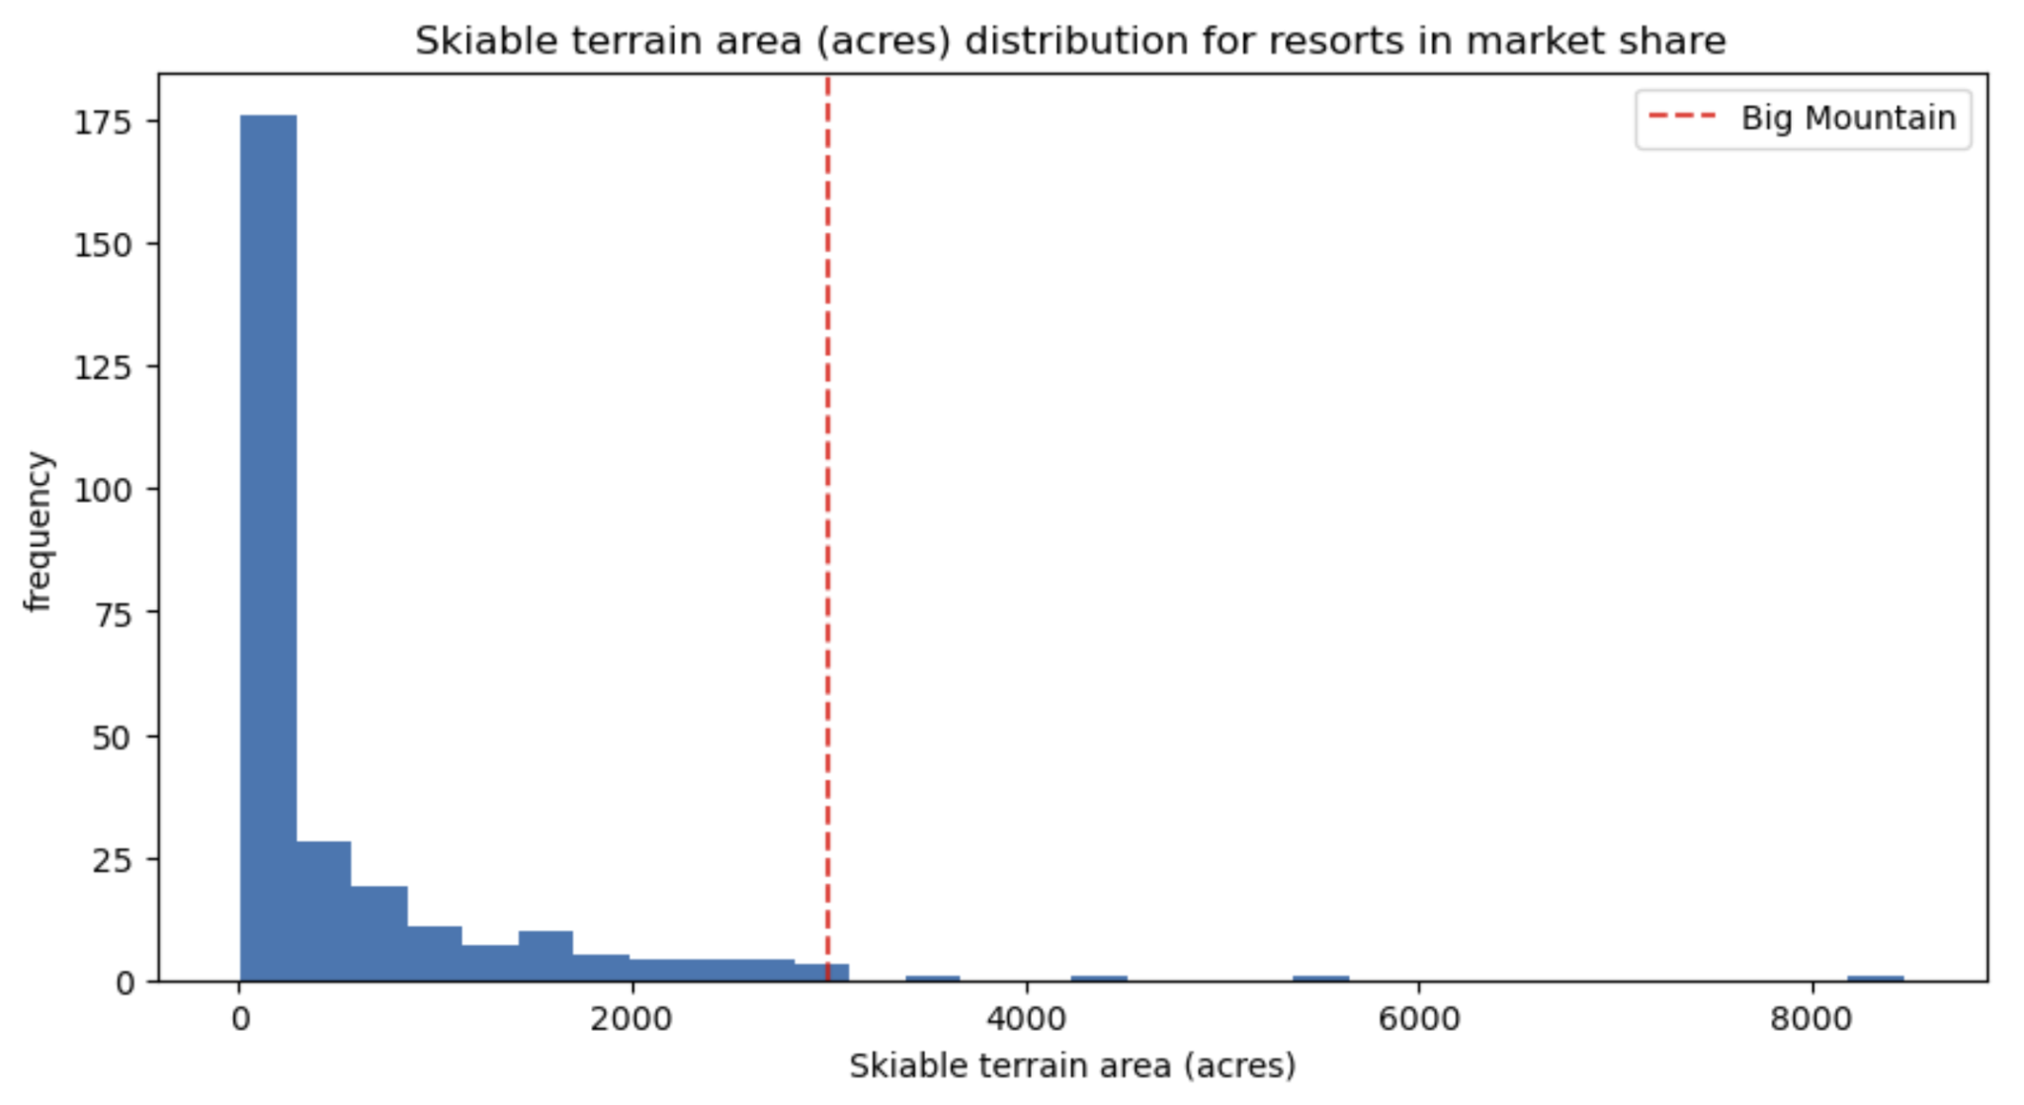
Modeling Results & Analysis (Big Mountain Cont.)

Slide 9
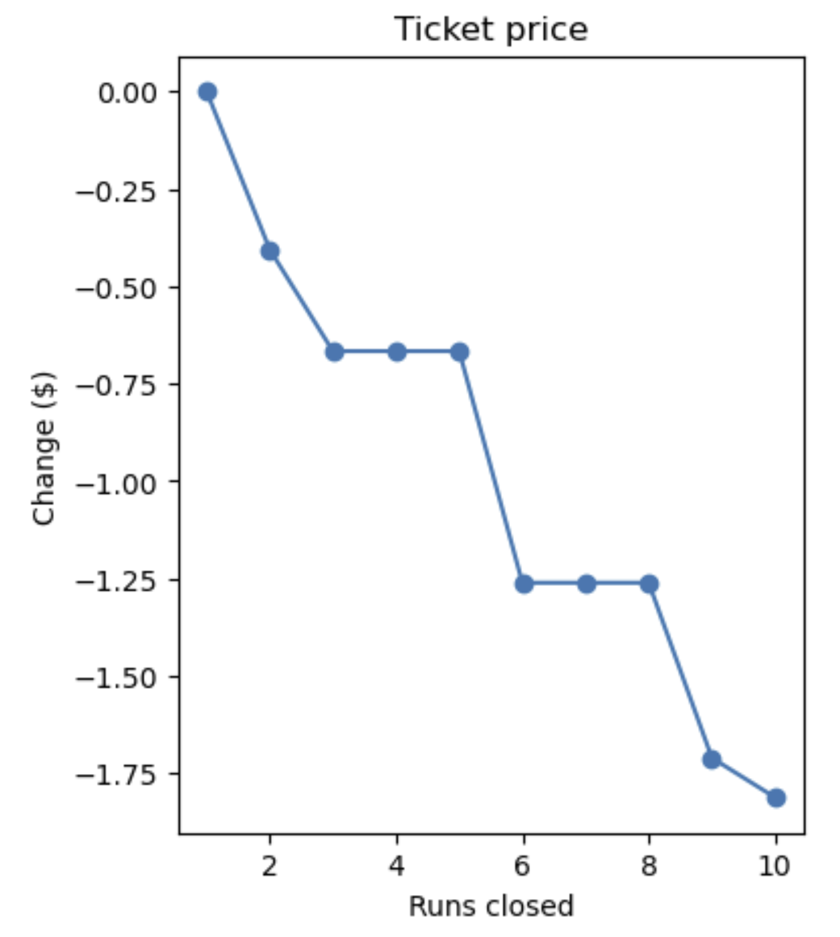
Modeling Results & Analysis
Scenario 1
Found that as runs closed, the ticket price decreased. The best number of closures would be 1 (no price change) or 5 (minimal price change).
Scenario 2
Found that this scenario would support a ticket price increase of $1.99 and should be implemented.
Scenario 3
No added value to ticket price so would not be recommended.
Scenario 4
No added value to ticket price so would not be recommended.

Slide 10
Summary & Conclusion
Big Mountain’s current ticket price is $81
Big Mountain ranks high in many important metrics
The model predicts Big Mountains price should be $95.87.
Due to the Mean Absolute Error, a conservative increase would be to $85.00 with current facilities.
Scenario 1 shows closing 1 run will not change ticket price.
Scenario 2 supports an increase in ticket price of $1.99.
Recommendation is to repurpose a run to add 150 feet of vertical drop with a new lift which would support a ticket price of $86.99.
This new ticket price generates over $10 million in additional revenue.

